Slide 1
Information Security (PII)
Gayana Fernando

Slide 2
How to provide security services?
Cryptographic techniques.
Encryption
Convert a meaningful message (plain text) into a message which has no meaning (cipher text/ garbage)
Decryption
Convert the message which has no meaning (cipher text/ garbage) back into the meaningful message (plain text).

Slide 3

Cryptographic Techniques
Message
“Stay Home”
Encryption
Decryption
KEY
Cipher Text
“#@!F #0M$”

Slide 4
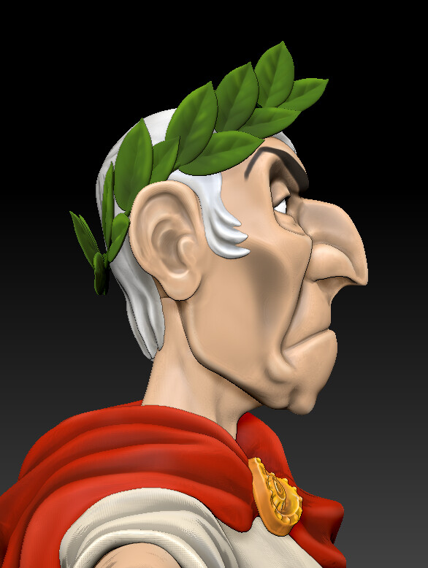
Classical Techniques
Substitution Cipher – Caesar Cipher
Transposition Techniques

Slide 5

Read this
FJMLPPFYIB /FP/KLQEFKD

Slide 6
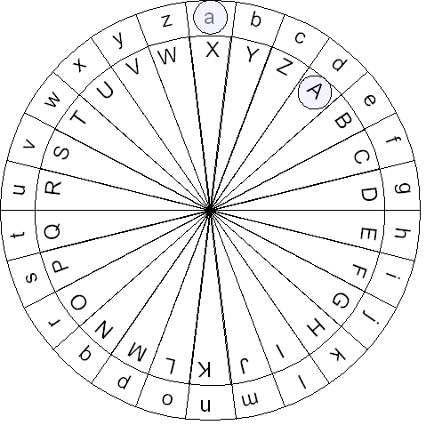
Read this
FJMLPPFYIB /FP/KLQEFKD

Slide 7

Task
Write a encrypt a sentence using Caesar Cipher and pass it to the other group to decrypt it. Max 5 words.

Slide 8
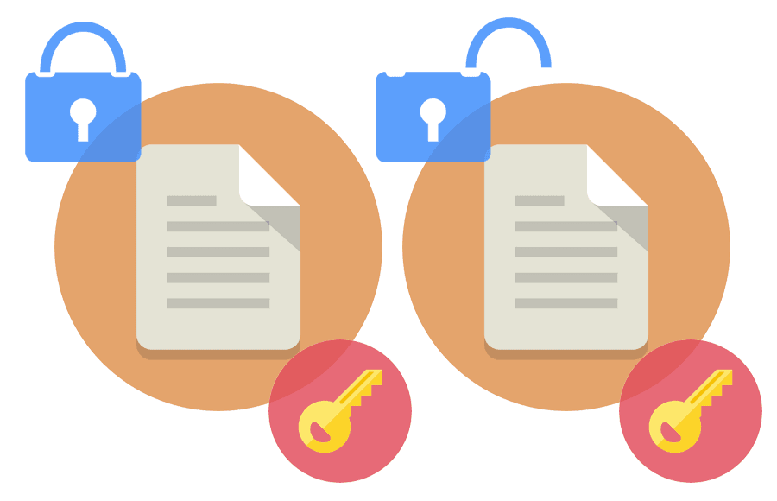
Modern Techniques
Single key encryption – Symmetric Encryption
Public key encryption – Asymmetric Encryption
SSL

Slide 9
End of Part II

